Slide 1
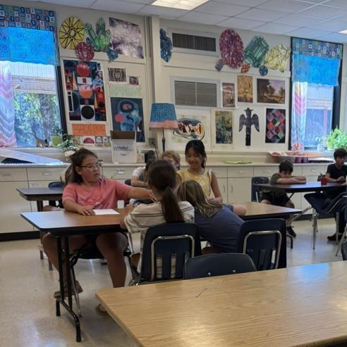
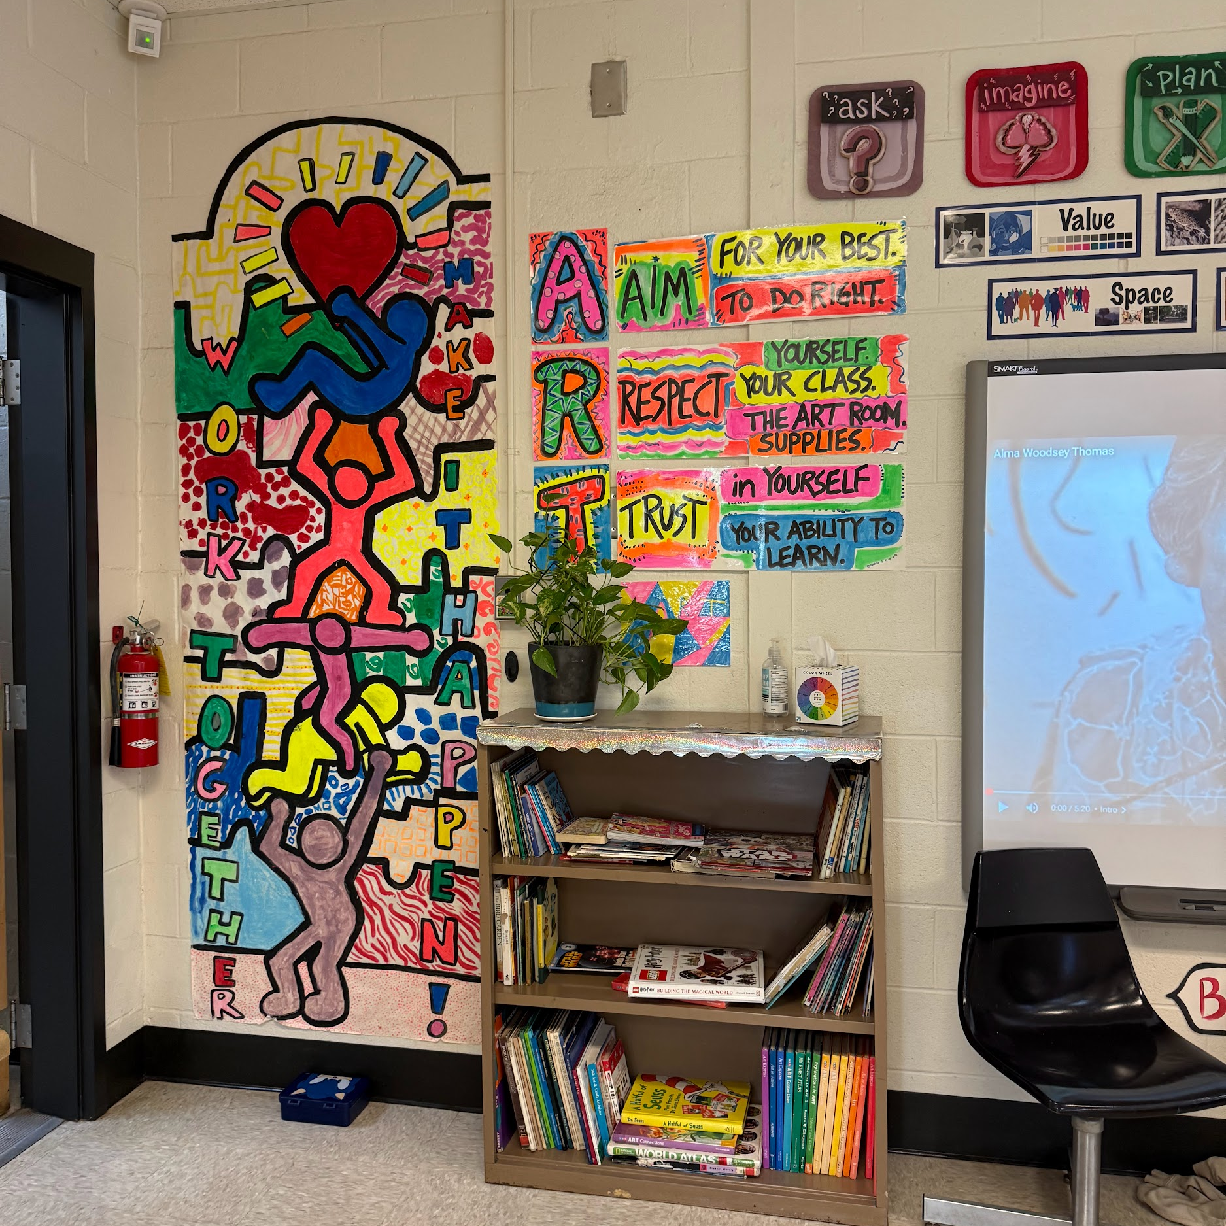

Attention and Distraction
Case-Study Project
Dagny Junghans and Nicole Rocheteau

Slide 2


Colham Ferry Elementary
Colham Ferry Elementary School is a public school located in Watkinsville Georgia. It is in a fringe rural setting.

Slide 3
Statistics
Female
48%
Male
52%
White
87.1%
Hispanic/Latino
6.5%
Two or more races
2.8%
Asian or Asian/Pacific Islander
2.3%
Black or African American
1.2%
Economically Disadvantaged
23%

Slide 4
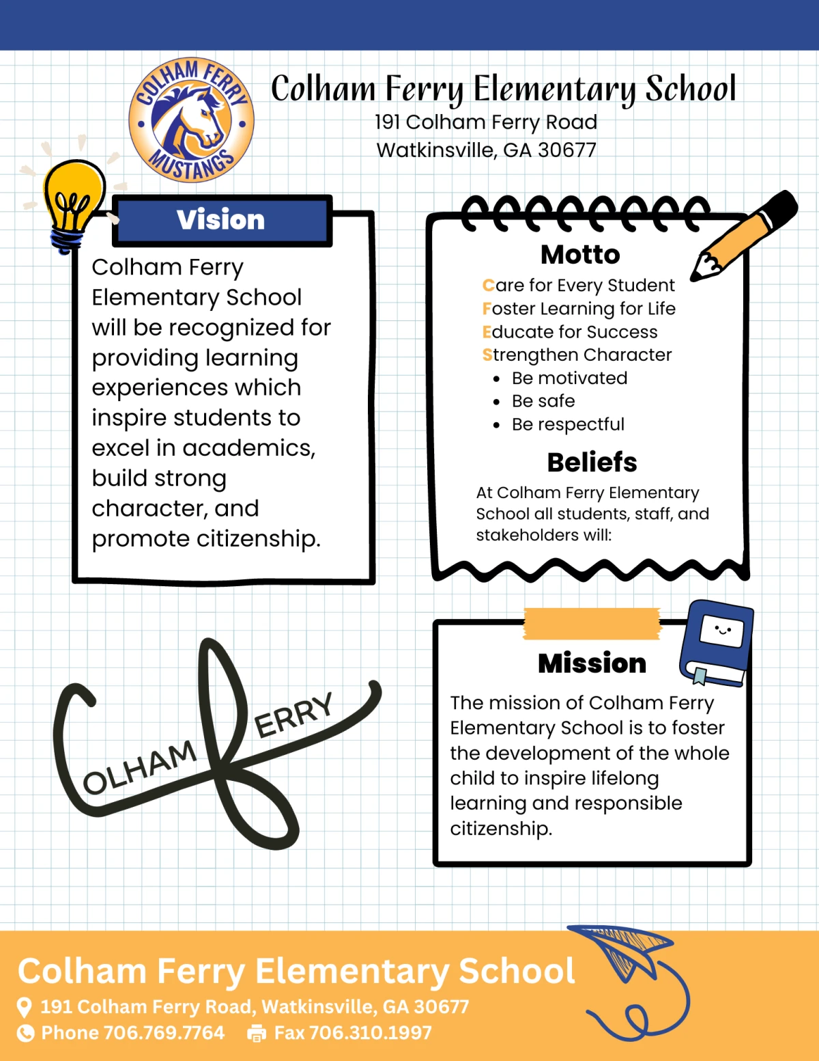

Slide 5
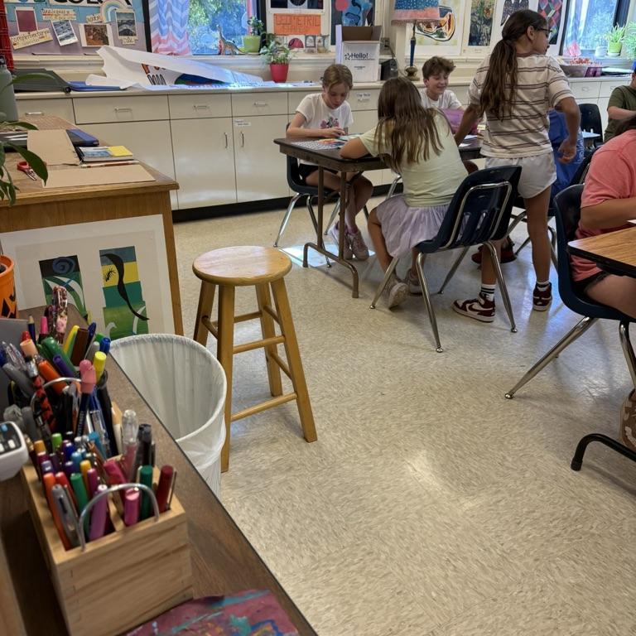
We observed a 4th and 5th grade class at Colham Ferry Elementary
Insights
We found that during class, students were often distracted from their work and not paying attention during instruction.

Slide 6
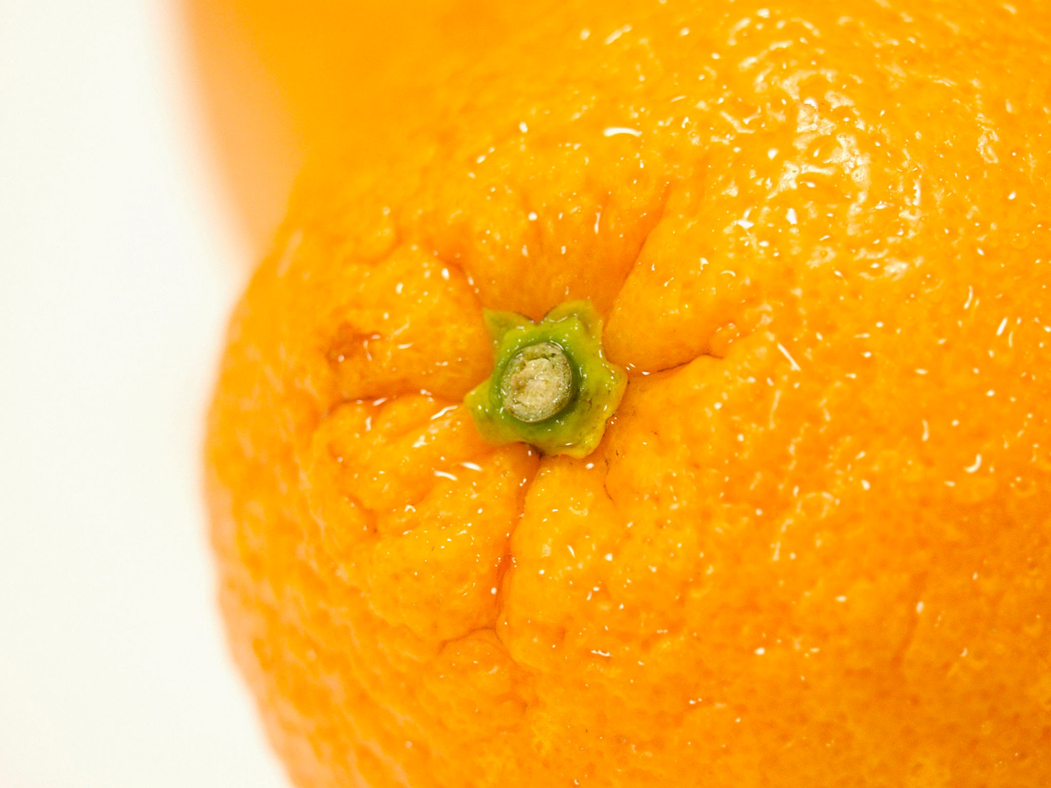

Documentation

Slide 7
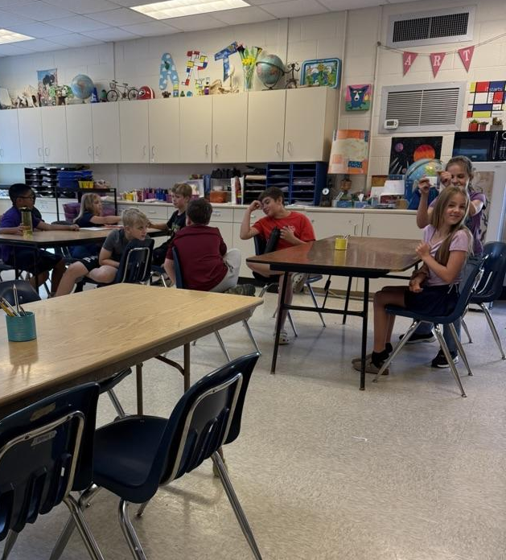
Distracted students at the beginning of class.
October 15, 2025

Slide 8
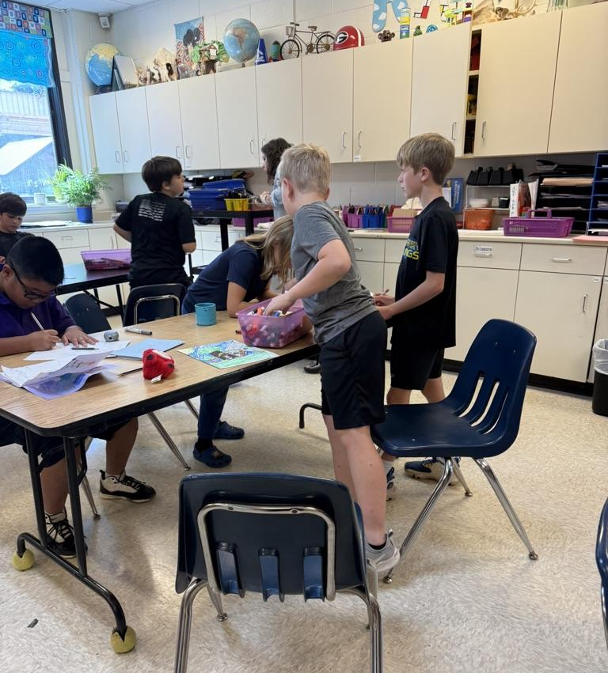
Students working, but also getting distracted by conversation.
October 15, 2025

Slide 9
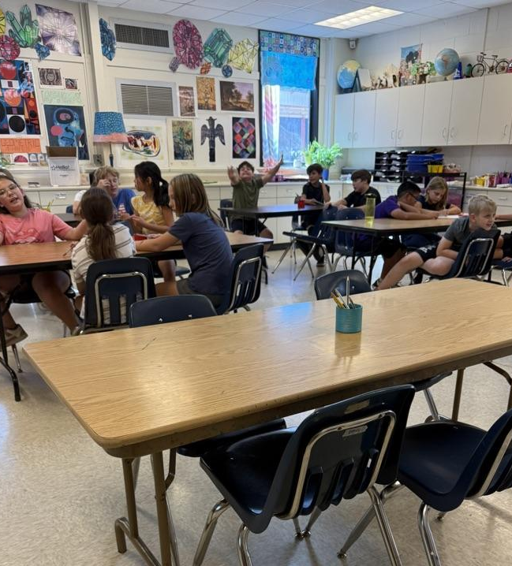
Hyper students shouting and throwing up their hands.
October 15, 2025

Slide 10
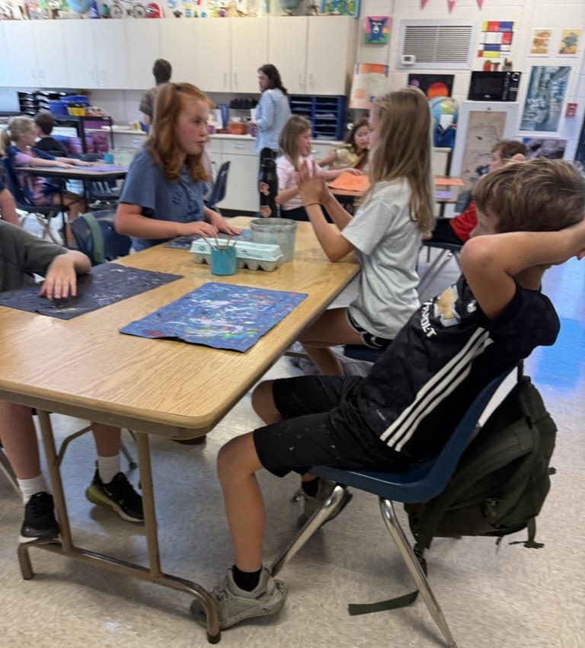
Students distracted by talking to peers.
October 15, 2025

Slide 11
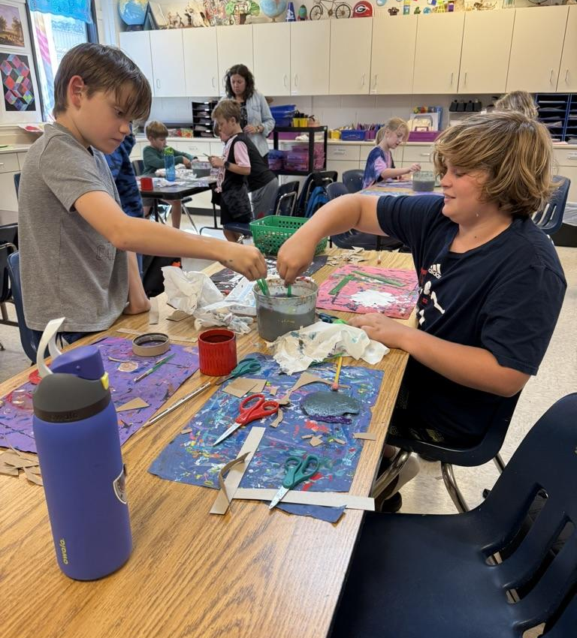
Students stirring their paint water to make a vortex.
October 15, 2025

Slide 12
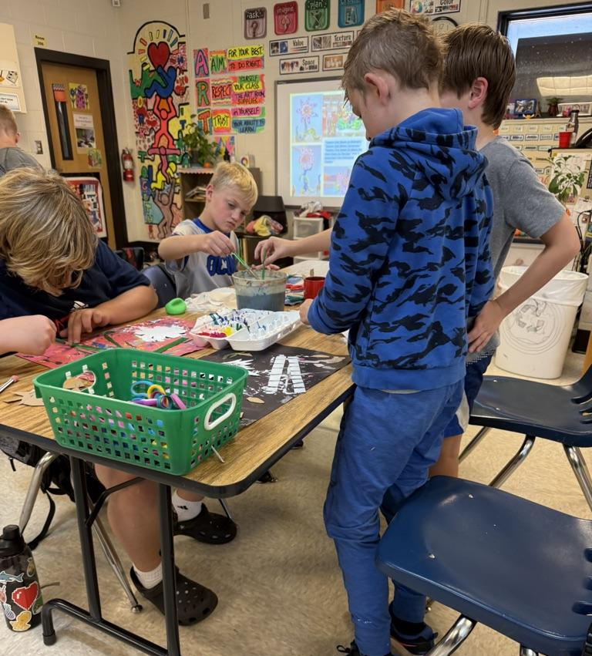
Students playing with the paint water by stirring and adding colors.
October 15, 2025

Slide 13
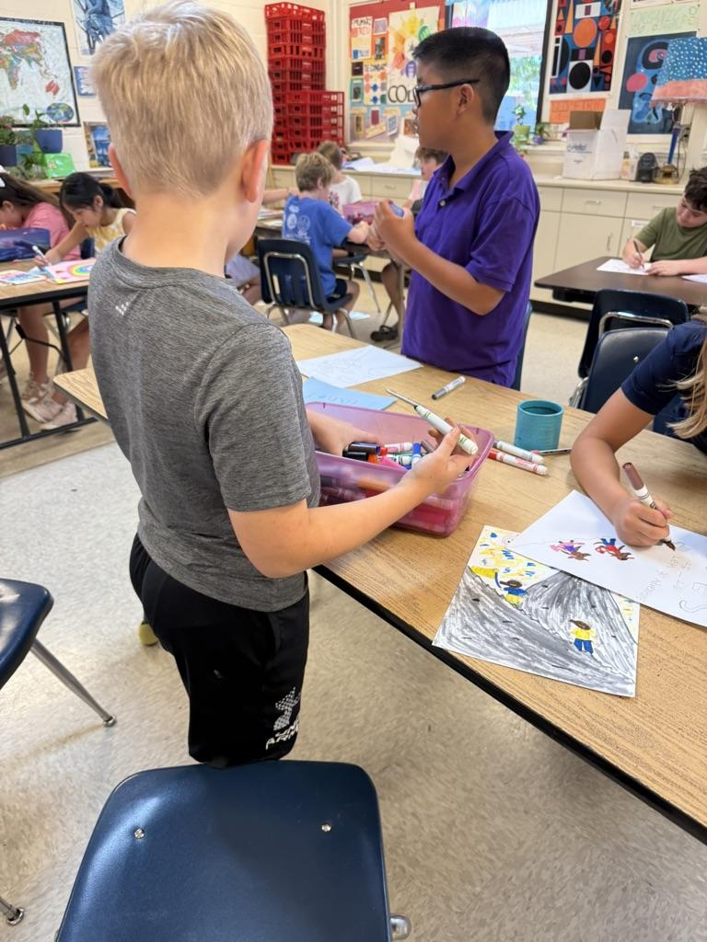
Students were throwing around markers and stirring the markers in the bins.
October 15, 2025

Slide 14
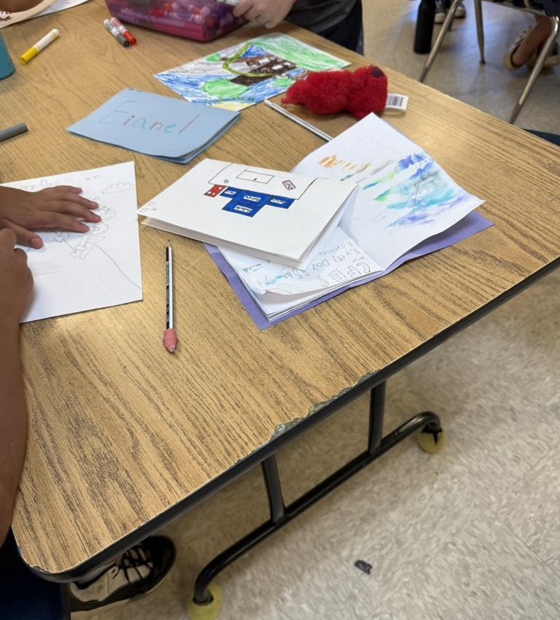
A student knocked over a water bottle while talking and got another students sketchbook wet.
October 15, 2025

Slide 15
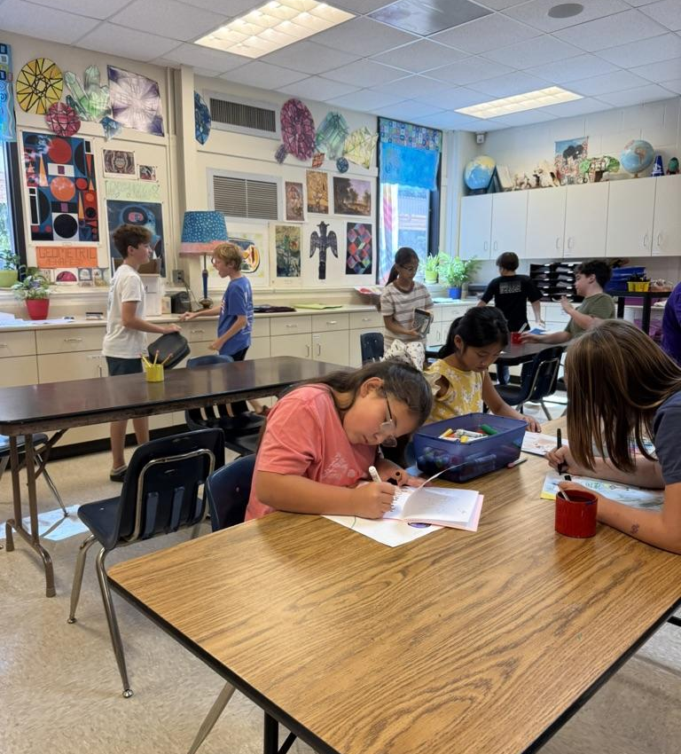
Students roughhousing in the back of the classroom.
October 15, 2025

Slide 16
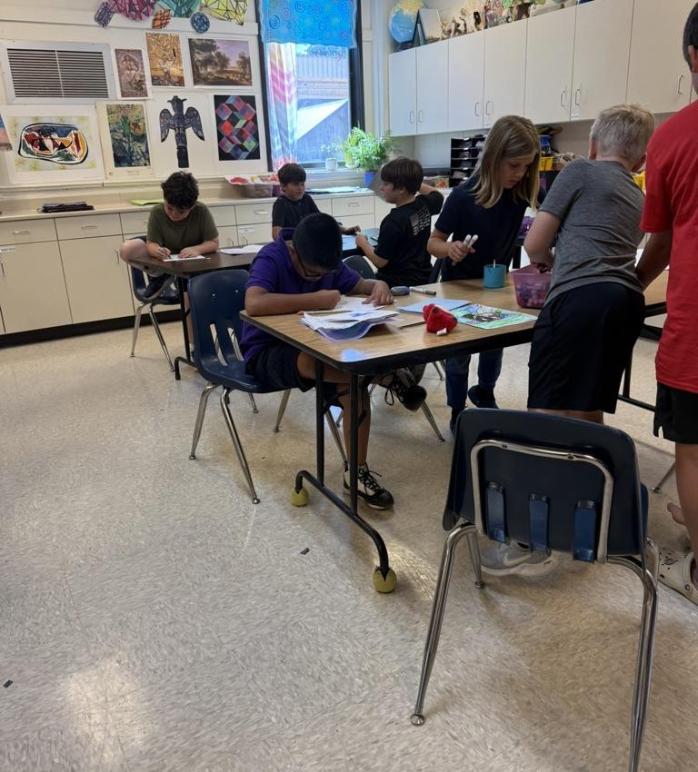
Students working, but also getting distracted by conversation.
October 15, 2025

Slide 17
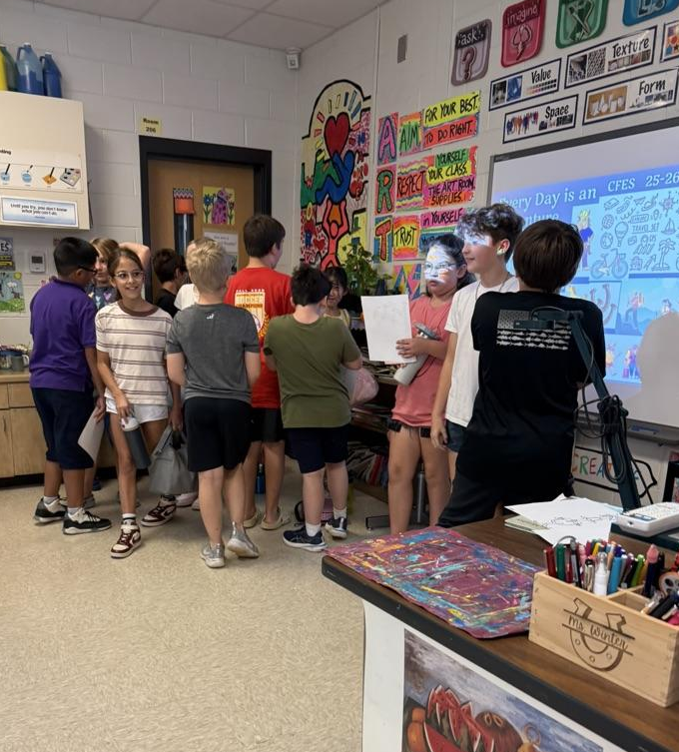
Students getting up to leave before they have finished cleaning their work stations.
October 15, 2025

Slide 18
Examples of field notes
10/15/25 observations
5th grade class
-Kids were talkative at the beginning of class, Ms. Winter had to talk over them with her microphone.
-Table of boys were throwing markers, another table joined in. They continued later after I asked them to stop.
-One of the boys at the all boys table in the corner finished his yearbook drawing earlier than everyone else, which seemed rushed.
-Most students did not finish in time despite Ms.Winter warning them that this was their last day to work on it.
-Students came in very distracted and moved around the room a lot before instruction began.
-The student who finished his project early mentioned that he wasn't very good at drawing and wished he was better. He was not very interested in the project topic either
4th grade class
-One child repeatedly interrupted Ms.Winters demo with unrelated/distracting questions
-kids seemed engaged in the project once it started, students for the most part worked consistently throughout class and got a good amount of progress done
-at the end of class students were very distracted when they were supposed to be cleaning up their tables
-The student who kept interrupting Ms. Winter seemed overstimulated. He got very upset when he couldn’t design a flower he liked and got anxious when he got paint on his hand. Ms. Winter told him it was alright and to take a deep breath.
-Student who previously cried and usually isn’t into the projects was engaged and working throughout class. He did start class a little rough by dipping pencils in the water bucket and Ms. Winter had to tell him to stop.
-Some students were playing with the scissors or jumping across the table to steal the adult scissors from others.

Slide 19
10/22/25 observations of disruptive/distracted behavior
5th grade class
-were very enthusiastic during discussion at beginning of class
-Two boys finished tracing their branches early and decided to treat being outside like recess. -They threw sticks into the woods and chased people with a spider
-Were very excited to draw their treehouses
4th grade class
-students came in talking
-During discussion students would not pay attention or ask a lot of irrelevant questions.
-Students did not pay attention to instructions and did not know what to do outside
-Students broke off tree branches or found huge ones.
-Students went far into the woods and Ms. Winter had to reprimand them
-Students wandered outside given boundaries when we went outdoors
-One student refused to work with others and spent the whole class and time back in the classroom trying to rig his stick to stand up on its own.
-One student put his hand in an ant hill and complained about being bitten
-Once inside the classroom, students were engaged in their work and excited to design their treehouses

Slide 20
11/5/25 observations of disruptive/distracted behavior
5th grade class
-The fifth grade class was enthusiastic about going outside
-Most students spent a lot of time collecting a lot of different materials
-Some boys got distracted when they found balls and played with those instead of collecting nature
-Students were excited to be able to use an adult tool like the hot glue gun
-Students struggled with the strength needed for the glue bottles
-At the back table student began taking the caps off the glue and coating their hands so they can peel it off
-One student drew with glue on the back of his hand
4th grade class
-a couple students did not want to add anything to their projects. They just sat and talked with their peers the whole class
-teachers approached these students and tried to directly engage them, but they did not seem interested
-At the end of class a few students tried put glue on their hands

Slide 21
Interpretation of documentation
-I speculate that distracted/disruptive behavior is a result of seeking peer approval rather than a lack of engagement in the lesson.
-Students are more often than not very engaged in the lessons and very enthusiastic and have a lot of ideas!
-during one visit, I observed two students going back and forth, engaging in disruptive behavior. They did not listen to me when I asked them to stop, and seemed to be encouraged by each other's reactions to their behavior.
-While this makes sense, as this is a time in their development when peer approval greatly affects their development, I wonder how we can approach this?
-How can we seem more approachable and relatable to the students? In what ways can we put ourselves on their level?
-The problems usually come from groups of boys who do not seem interested in art and often say that they can’t draw or that their drawings don't look good.

Slide 22
Key Insights
Peer Approval
Interest in Lesson
Interest in Art
We observed that a lot of student misbehavior was contingent on peer approval.
An important factor of student attention to the lesson was dependent on how interested they were in the lesson.
Another important factor that affected student attention was if they were interested in art as a subject or not.

Slide 23
Resources

Slide 24
Books
Hacking School Discipline
9 Ways to Create A Culture of Empathy and Responsibility Using Restorative Justice
By: Nathan Maynard and Brad Weinstein
This book focuses on more positive ways to discipline students using restorative justice practices instead of traditional methods of punishment.
Better Than Carrots or Sticks
Restorative Practices for Positive Classroom Management
By: Dominique Smith, Douglas Fisher, and Nancy Frey
This book is about classroom management. It recommends that teachers empower their students to address and correct misbehavior themselves rather than using teacher praise and punishment,

Slide 25
Journal Articles
Distracted, Bored, and Disengaged
Improving Student Attitudes
Peer Influence on Classroom Attention
By: Paulette Tranquilli
This Journal delves into the cause of negative student attitudes in the art classroom. Upon analysis of the data collected for the study, it is revealed that negative student attitudes are primarily caused by lack of confidence in their artistic skills. Tranquilli shares new data after solutions to reduce lack of confidence in art-making were implemented, showing a significant increase in self reflection, artistic improvement, and critical thinking skills.
By: Diane Felmlee, Donna Eder, and Wai-Ying Tsu
This journal article looks at the influence of peers in the elementary classroom. They measured student behavioral attention and found that one students attention causes other students to lose attention. They conclude that teachers should pair lower ability students with higher ability students to encourage good behavior.
By: Sharon Kay Stout
This article goes over how the current generation of students function differently when it comes to engagement, and identifies ways in which educators can adjust their teaching methods to combat this. Stout presents a recent qualitative research study on the best ways to engage Gen Z students in the classroom.

Slide 26
Online Sources
Cult of Pedagogy
Distract the Distractor: Stop Off-Task Behavior Without Drama
Cult of Pedagogy
Five Questions to Ask Yourself About Your Unmotivated Students
By: Jennifer Gonzalez
This website shares the common struggle of unmotivated student in the classroom, and how to approach it in all its complexity. Gonzalez brings up how we as educators are quick to blame things like parents or technology, unwilling to give the issue any deeper thought. Gonzalez then asks the reader to analyze certain aspects of their teaching, like student relationships and student freedom, and shares several resources and strategies to improve the classroom experience.
By: Jennifer Gonzalez
This website introduces an unconventional method to approaching distracted behavior. The author suggests that instead of calling attention to distracted behavior, that the teacher re-engages the student with a strategic context-based question.

Slide 27
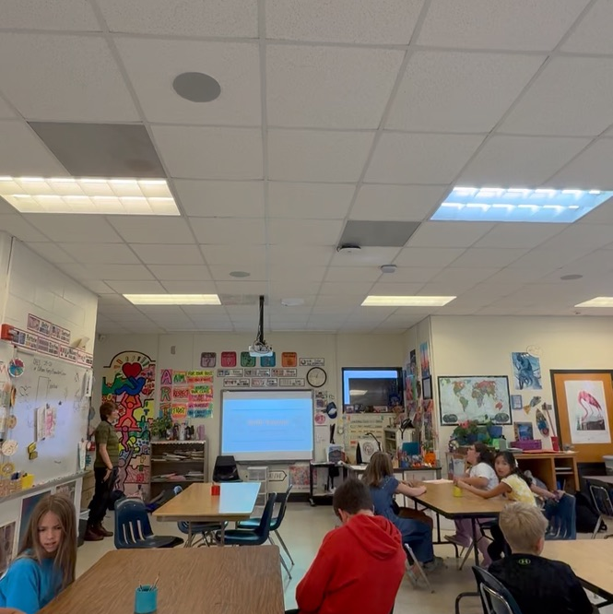
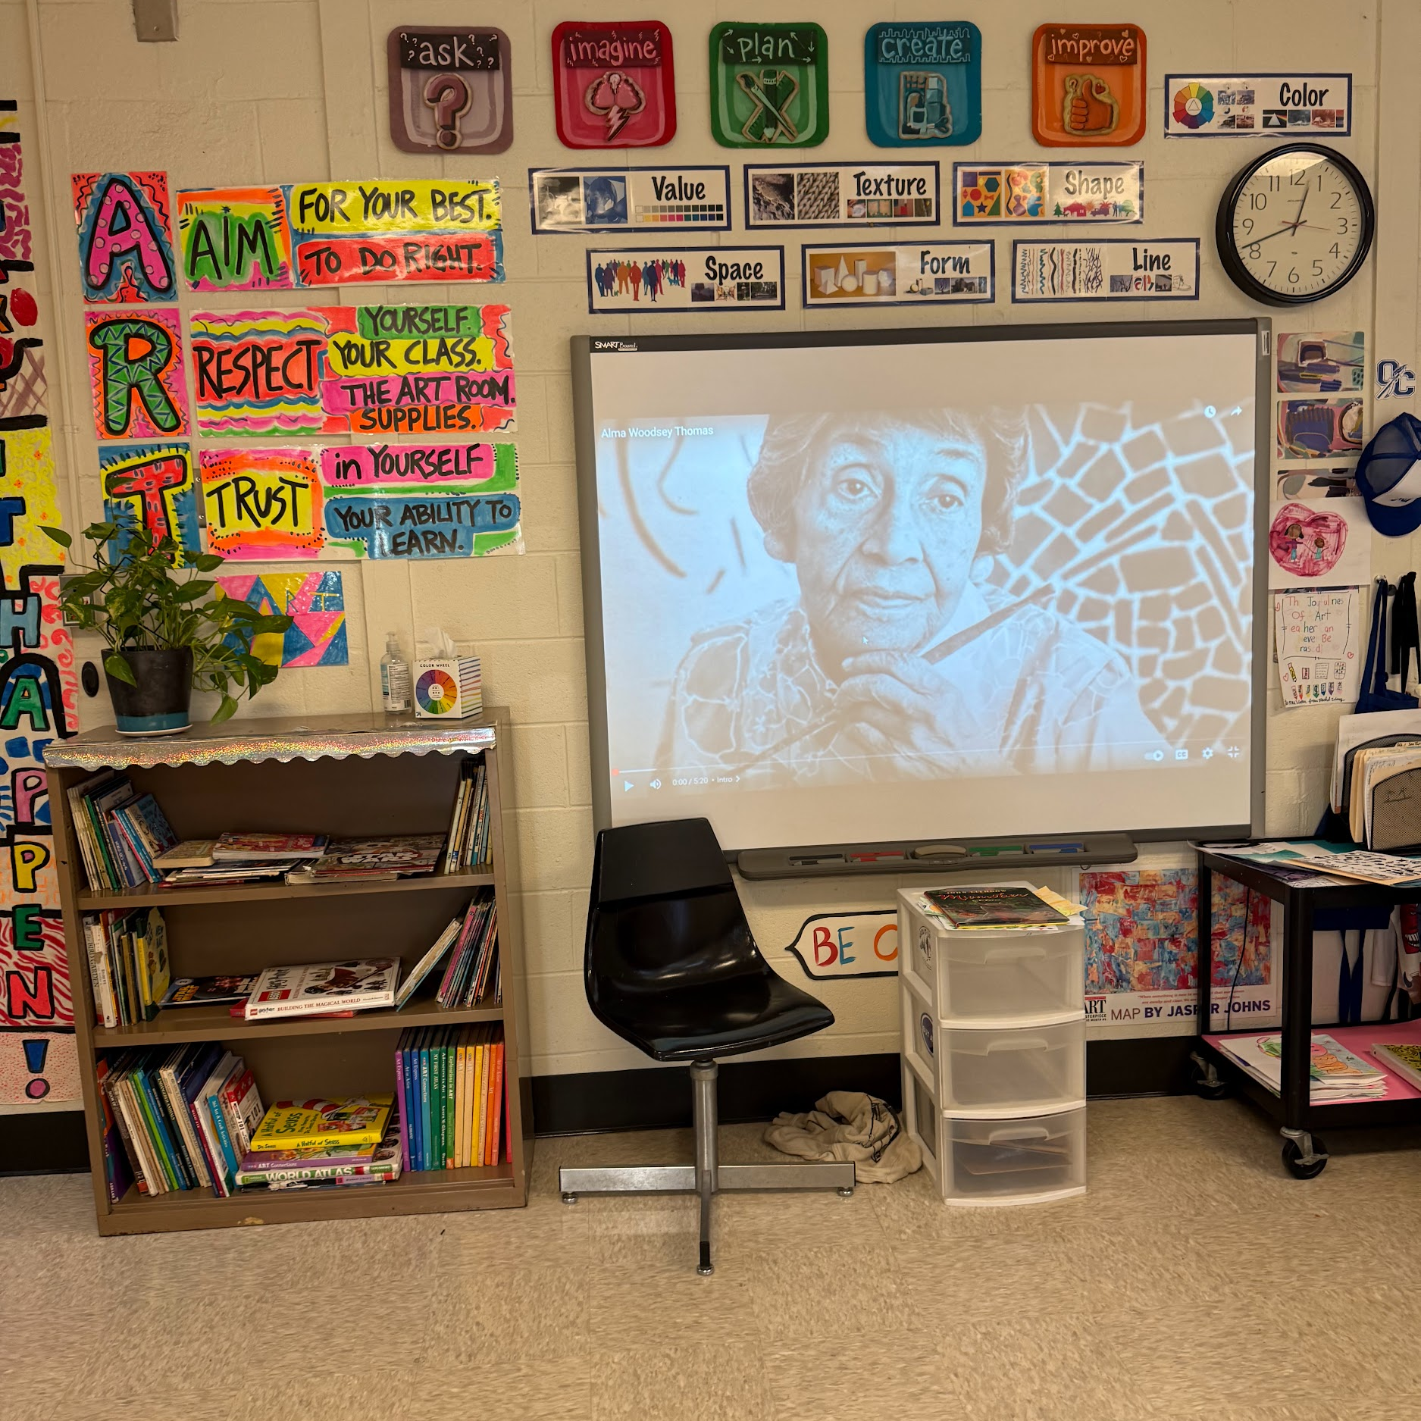
Instructional Teaching Strategies
-positive and energized teaching
-questions during presentation to keep students engaged
-giving students lots of freedom and options while making

Slide 28
Behavioral Management Teaching Strategies
-Using restorative practices like restorative justice in place of punishment
-building trust and community
-discussing effects of actions
-formal conferences for those affected to find solutions

Slide 29
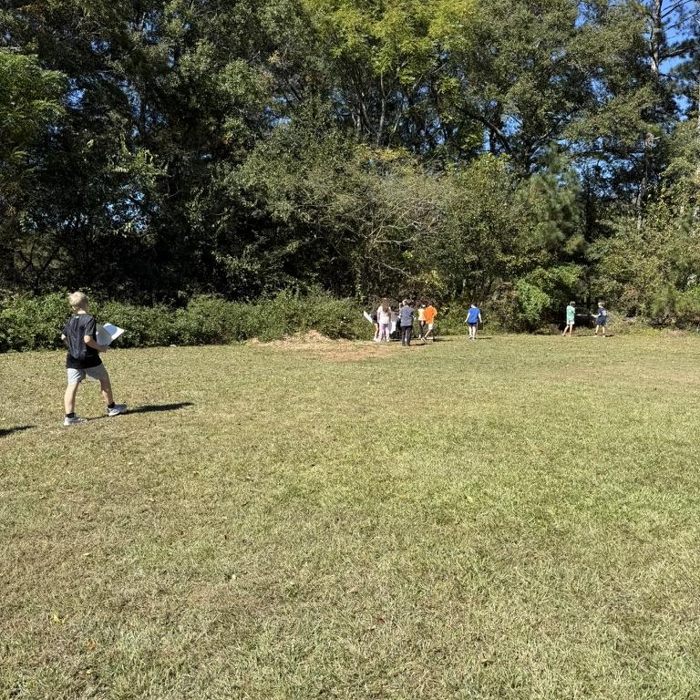
Environmental Teaching Strategies
When changing environments
-structured approach
-clear expectations
-constant monitoring
-be aware of what may distract students

Slide 30
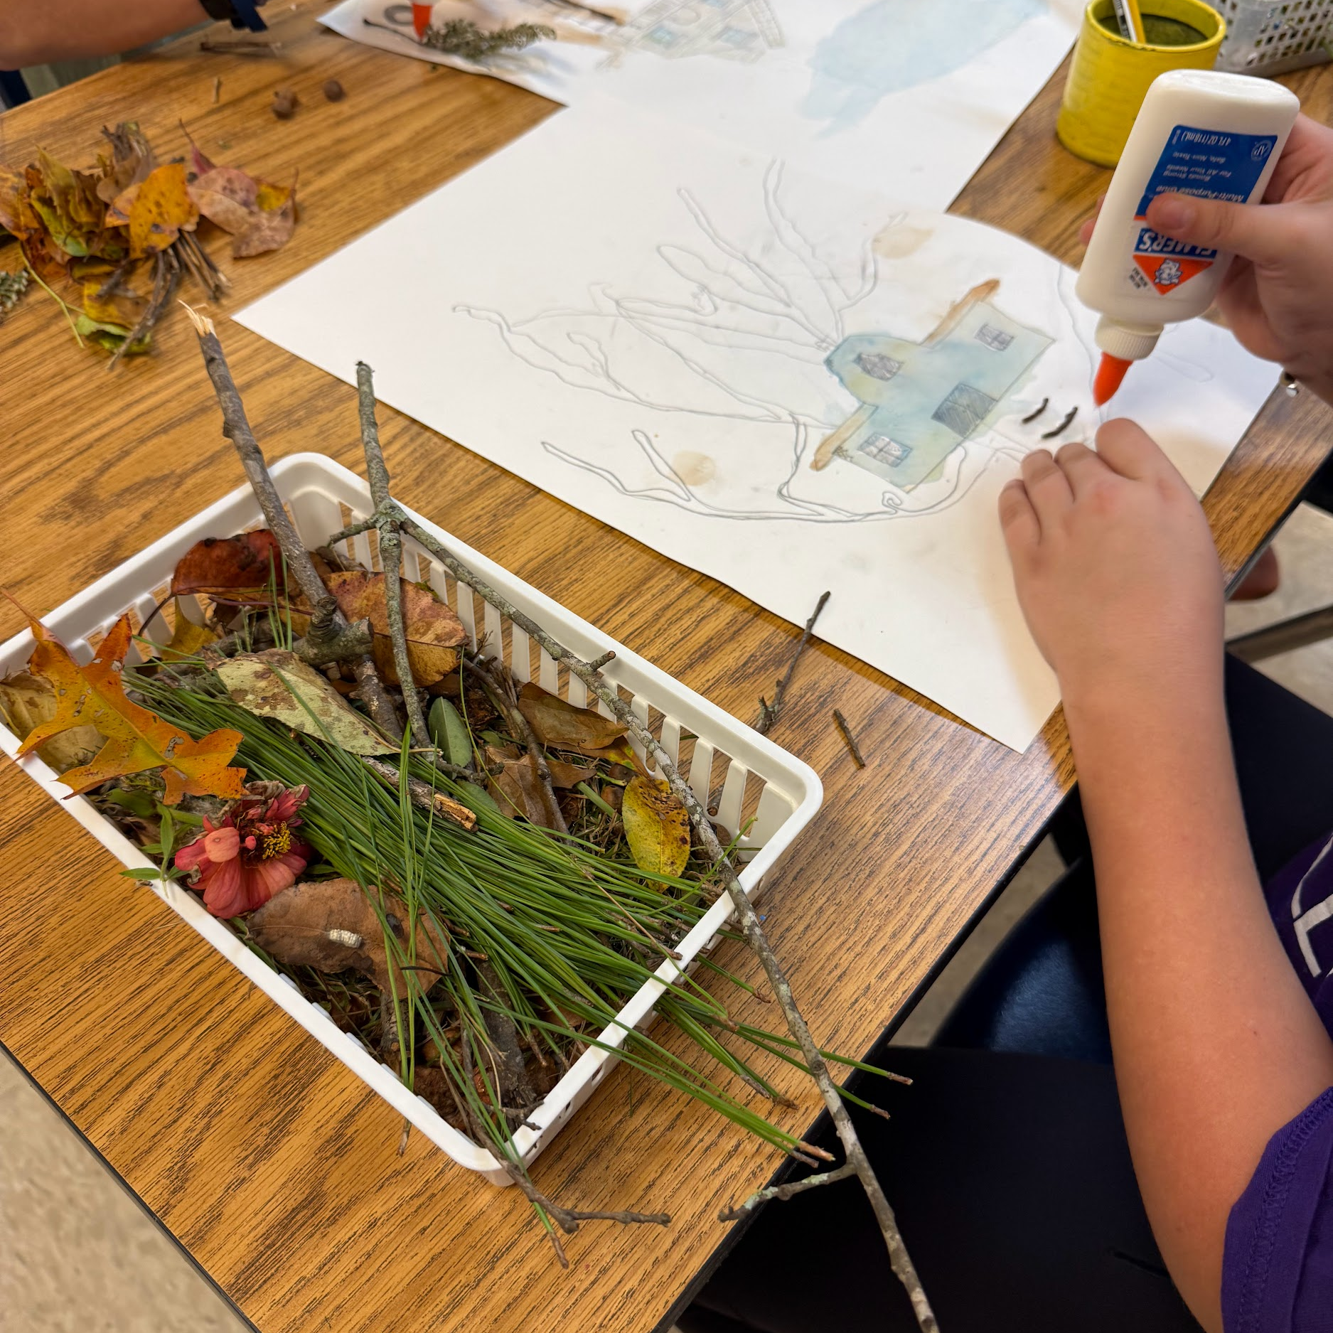
Alternate Materials
Some students prefer a more tactile art making process rather than just drawing in pencil. For example students can use materials from nature to put on their artwork and give it texture.

Slide 31
Resources
Felmlee, D., Eder, D., & Tsui, W.-Y. (1985). Peer Influence on Classroom Attention. Social Psychology Quarterly, 48(3), 215–226.
https://doi.org/10.2307/3033682
Gonzalez, J. (2019, July 10). 5 questions to ask yourself about your unmotivated students. Cult of Pedagogy. https://www.cultofpedagogy.com/student-motivation/
Gonzalez, J. (2025, September 16). Distract the distractor: Stop off-task behavior without drama. Cult of Pedagogy. https://www.cultofpedagogy.com/distract-the-distractor/
Maynard, N., Holden, B., & Weinstein, B. (2020). Hacking school discipline: 9 ways to create a culture of empathy & responsibility using restorative justice. Tantor Audio.
Smith, D., Fisher, D., & Frey, N. (2015). Better than carrots or sticks: Restorative practices for positive classroom management. ASCD.
Stout, S. K. (2024). Distracted, bored, and disengaged: How to reengage Gen Z learners in the secondary school classroom. In Dissertation Abstracts International Section A: Humanities and Social Sciences (Vol. 85, Issue 7–A).
Tranquilli, P. (1999). Improving Student Attitudes through Increased Confidence and Accountability in Art.

